Slide 1
Employment Effects of Promoting Training and Vocational Education (TVET) in Vietnam
Christoph Ehlert
Jochen Kluve
Marc Witte
Labour Market and Industrial Relations in Vietnam
Nürnberg, 08.10.2012

Slide 2
1 Programme
Two GIZ programmes:
Promotion of TVET, Vietnam (2006-2010) ← Evaluation
Programme Vocational Training 2008 (2010-2014)
Objective:
The provision of demand-oriented trained and qualified labour force for sectors with growth potential

Slide 3
1 Programme
Means for achieving this objective:
Revision of training curricula
Adaptation of learning and teaching materials
Capacity building (teachers and management)
Private sector cooperation
Technical support (e.g. machinery, etc.)
Cooperation (NIVT, GDVT, TVET institutes)

Slide 4
2 Potential effects
The programme may lead to:
Improvement of training quality
Better adaption of training to labour market needs
More employment
At the same time, the implemented monitoring system itself may affect performance in the long run

Slide 5
3 Implementing a monitoring system
Sustainable monitoring approach
integrates existing tracer studies
developed according to schools’ and GDVT’s requirements
fulfills information needs on enterprises’ qualification requirements, graduates’ labour market performance and schools’ training performance
Two-tier approach: School-based and policy-supported

Slide 6
3 Implementing a monitoring system
Bi-annual surveys
Baseline survey in school (contact data, demographics, training quality, future plans)
Follow-up survey after 6 months (labour market/job characteristics, training quality)
Data is processed and evaluated by schools
NIVT does consistency checking and merging
Report is written by NIVT

Slide 7
4 Evaluation design
Cross-Sectional Difference-in-Differences
Hypothetical supported minus hypothetical unsupported occupations in the control schools
Supported minus unsupported occupations in the treatment schools
→ Accounts for differences in labour markets and differences between occupations
Group assignment |  | Occupations
 |  | Supported | Unsupported
Schools | Treatment | Participants | Non-participants
 | Control | Hypothetical participants | Hypothetical non-participants

Slide 8
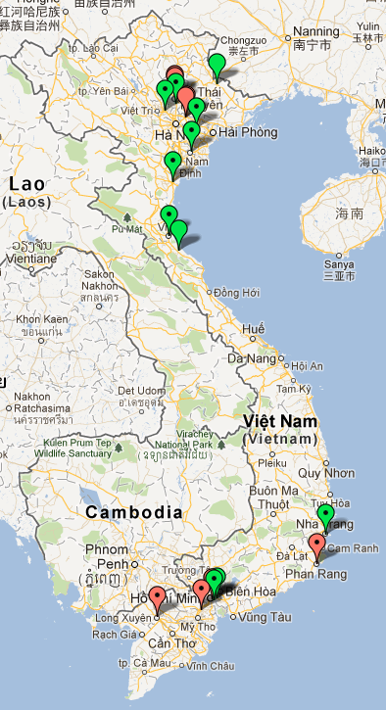
5 Dataset
Covers years 2009-2012 and 24 schools in 2012
Evaluation employs data from 2010 with information on 17 schools:
9 treatment, 8 control schools
4422 observations in the baseline survey
2694 observations in the follow-up survey

Slide 9
6 Descriptive statistics
General sample characteristics in 2010
av. age 21.5
25% female
28% have prior VT
24% have a job at graduation
av. wage 2.9 million VND
male: 3.1 million VND
female: 2.0 million VND

Slide 10
6 Descriptive statistics
 | control schools |  |  |  |  |  |  | treated schools
 | (1) |  | (2) |  | (3) |  |  | (4) |  | (5) |  | (6)
 | control schools total |  | untreated occ. |  | treated occ. |  |  | treated schools total |  | untreated occ. |  | treated occ.
baseline | Mean | SD | Mean | SD | Mean | SD |  | Mean | SD | Mean | SD | Mean | SD
age | 21.48 | 2.33 | 21.82 | 2.21 | 21.21 | 2.39 |  | 21.83 | 2.03 | 21.98 | 1.55 | 21.73 | 2.31
female | 0.09 | 0.29 | 0.16 | 0.37 | 0.04 | 0.20 |  | 0.27 | 0.44 | 0.42 | 0.49 | 0.17 | 0.37
schooling | 4.05 | 0.27 | 4.09 | 0.31 | 3.99 | 0.18 |  | 3.76 | 0.43 | 3.78 | 0.41 | 3.73 | 0.44
VT degree rank | 2.67 | 0.81 | 2.71 | 0.75 | 2.64 | 0.85 |  | 2.56 | 0.78 | 2.48 | 0.74 | 2.63 | 0.81
prior VT | 0.60 | 0.49 | 0.52 | 0.50 | 0.65 | 0.48 |  | 0.22 | 0.41 | 0.09 | 0.28 | 0.38 | 0.48
job at graduation | 0.02 | 0.12 | 0.01 | 0.12 | 0.02 | 0.13 |  | 0.28 | 0.45 | 0.13 | 0.33 | 0.38 | 0.49
N | 1180 |  | 505 |  | 675 |  |  | 3242 |  | 1346 |  | 1896
Follow-up
employed | 0.74 | 0.44 | 0.78 | 0.41 | 0.70 | 0.46 |  | 0.79 | 0.41 | 0.73 | 0.45 | 0.81 | 0.39
N | 901 |  | 435 |  | 466 |  |  | 1793 |  | 451 |  | 1342

Slide 11
7 Programme impact on employment
 | (1) |  |  | (2) |  |  | (3) |  |  | (4)
 | coeff. | t |  | coeff. | t |  | coeff. | t |  | coeff. | t
Treated school | -0.061**** | -2.04 |  | 0.002** | -0.05 |  | 0.161*** | -4.52 |  | 0.247*** | -4.64
Supported occupation | -0.126**** | -3.93 |  | -0.109*** | -3.35 |  | -0.186*** | -2.75 |  | -0.155*** | -2.01
Tr. school*supported occ. | 0.167*** | -3.82 |  | 0.108*** | -2.36 |  | 0.272*** | -3.93 |  | 0.217** | -2.44
Age | 0.013*** | -3.64 |  | 0.013*** | -3.44 |  | 0.008** | -1.97 |  | 0.008** | -1.89
Sex | -0.099**** | -3.85 |  | -0.105*** | -3.76 |  | -0.014** | -0.35 |  | -0.023** | -0.58
North | 0.825*** | -11.63 |  | 0.774*** | -9.99 |  | -0.608*** | -4.22 |  | -0.807*** | -4.16
VT degree rank |  |  |  | X |  |  |  |  |  | X
Schooling degree |  |  |  |  |  |  | X |  |  | X
Constant | 0.722*** | -7.99 |  | 0.668*** | -6.78 |  | 0.557*** | -3.8 |  | 0.583*** | -3.65
N | 2664 |  |  | 2184 |  |  | 586 |  |  | 570
Adj. R-Square | 0.09 |  |  | 0.11 |  |  | 0.14 |  |  | 0.17

Slide 12
7 Programme impact on satisfaction
 | (1) |  |  | (2) |  |  | (3) |  |  |  | (4) |  |  |  | (5)
Satisfaction with | Relevance of skills |  |  | Curriculum |  |  | Overall training |  |  |  | Theoretical courses |  |  |  | Practical courses
 | Coeff. | t |  | Coeff. | t |  | Coeff. |  | t |  | Coeff. |  | t |  | Coeff. |  | t
Treated school | 0.251** | -1.36 |  | 0.405*** | -2.58 |  | -1.515*** |  | -8.23 |  | 0.278* |  | -1.71 |  | -0.079** |  | -0.51
Supp. occupation | 0.461*** | -3.75 |  | 0.162** | -1.16 |  | -1.168*** |  | -6.49 |  | 0.381** |  | -2.43 |  | 0.128* |  | -0.98
Tr. school* supported occ. | -0.422** | -1.88 |  | -0.890*** | -4.49 |  | 0.403** |  | -1.72 |  | -0.845*** |  | -4.12 |  | -0.932*** |  | -4.73
N | 1443 |  |  | 2176 |  |  | 2042 |  |  |  | 2103 |  |  |  | 2322
p | 0.003 |  |  | 0.010 |  |  | 0.070 |  |  |  | 0.007 |  |  |  | 0.026

Slide 13
8 Conclusion
Evaluation of “Promotion of TVET” let to a
sustainable monitoring system for TVET
that is continuously growing (24 schools in 2012) and
involves all major actors of the TVET system in Vietnam
Impact of “Promotion of TVET” is
significantly positive on employment and robust to changes in specifications
mixed on subjective training evaluation scores

