Slide 1
Necessity and opportunity entrepreneurship in rural Vietnam – characteristics and performance
Prof. Dr. Javier Revilla Diez
Dipl. Geogr. Jürgen Brünjes
Internationale Expertinnen- und Expertentagung:
Arbeitsbeziehungen und Arbeitsmarkt in Vietnam
Institute of Economic and Cultural Geography
Leibniz Universität Hannover
08/10/2012
Notes:
In the next twenty minutes I will…

Slide 2
Outline
The Research Project
Paper presentation:
‚Necessity and opportunity entrepreneurship in rural Vietnam – characteristics and performance‘

Slide 3
Research project - concept
DFG FOR 756:
“Impact of shocks on the vulnerability to poverty: consequences for development of emerging Southeast Asian economies”
Agriculture
Risk preferences and perceptions
non-agricultural income
Financial
Institutions
Vulnerability
and
HH dynamics
Management
of Vulnerability
Database
Financial institutions and employment
Economic
Geography
Notes:
Schmissigen Namen
Teilprojekt 5:
“Economic restructuring and responses to crisis: actors, institutions and developments in rural Vietnam/Thailand”

Slide 4
Research project – the sub-project
Research themes of Economic Geography sub-project
Regional development in rural areas
  Rural non-farm employment and vulnerability
  Migration and remittances
  Human capacity building and rural industrialization
  Local institutions and the performance of companies

Slide 5
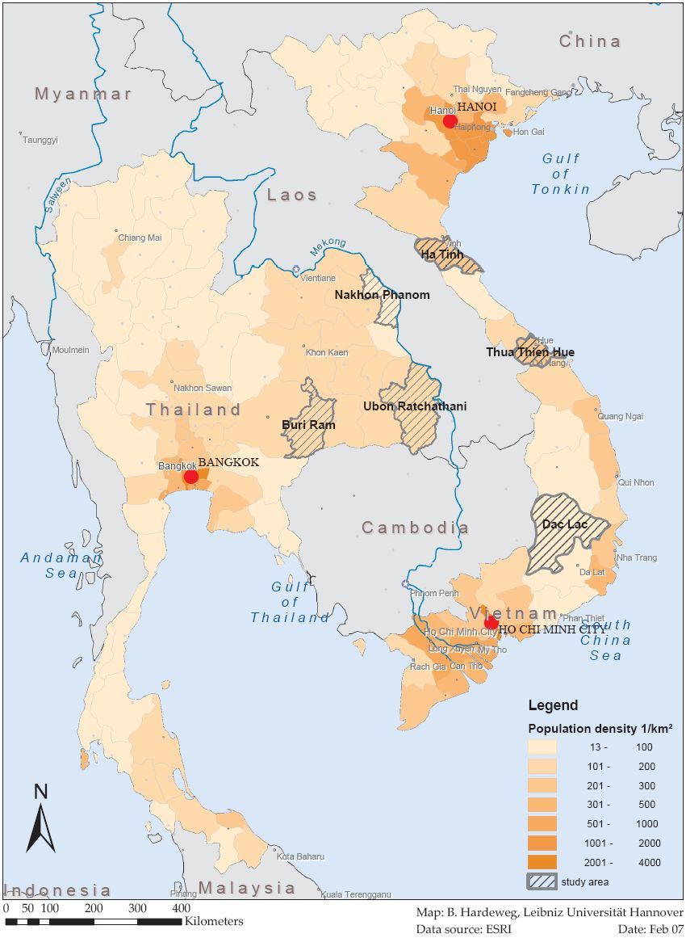
Research project – the research provinces
- Emerging markets Thailand and Vietnam: 3 provinces
- Purposive selection:
Border provinces
North-Eastern Thailand
Central Coast + Central Highland in Vietnam
Relatively low income levels
Significant dependence on agricultural income
assumed risky environment
- Household panel (2.200 per country interviewed in 2007, 2008 and 2010)
- Company survey in 2007 and 2010 (50-100 per Province)
Notes:
Das methodische Vorgehen teilt sich in drei Schritte auf. Erstens: Mittels einer Haushaltsbefragung von jeweils 2.200 Haushalten in Thailand und Vietnam (siehe Karte) sollen individuelle Strategien der ländlichen Bevölkerung dargestellt werden. Im zweiten Schritt werden mittels einer Unternehmensbefragung von jeweils 250 Unternehmen in beiden Ländern außerlandwirtschaftliche Beschäftigungsmöglichkeiten untersucht. Ergänzt wird dies durch einen letzten Schritt, in dem mit regional Verantwortlichen die Stärken und Schwächen des institutionellen Rahmens herausgearbeitet werden.

Slide 6
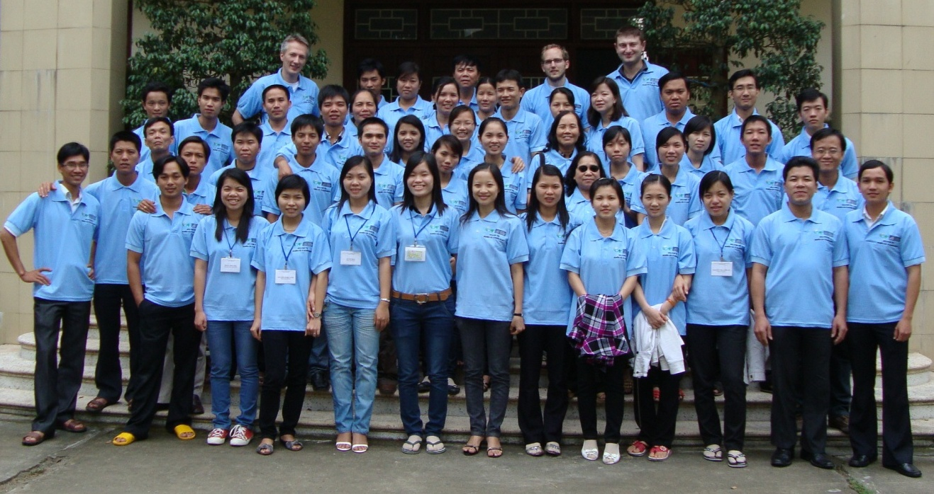
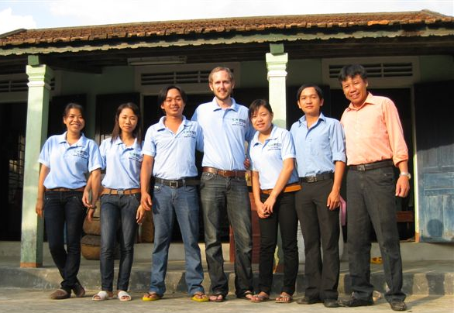
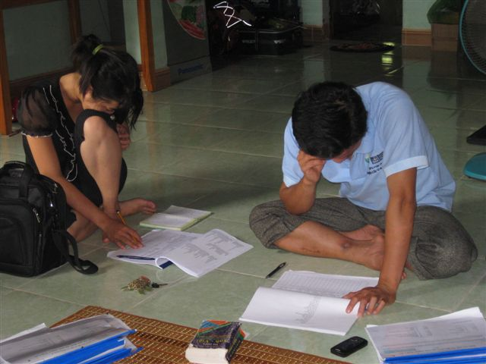
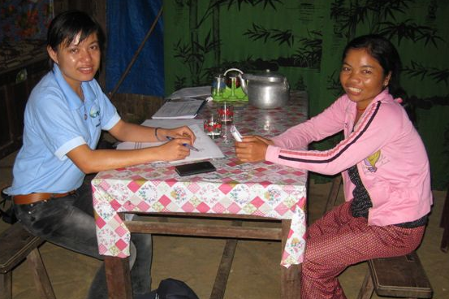
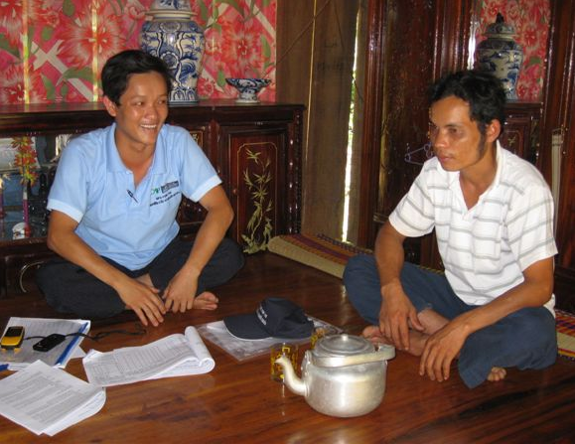
Vietnam household survey 2010
Source: Own Photographs
Notes:
Fotos stellen die Befragungssituation dar.
6 Teams in Vietnam, je zwei Teams je Provinz
Intensives Training
Hue
Teams mit professionellen Befragern und Studenten

Slide 7
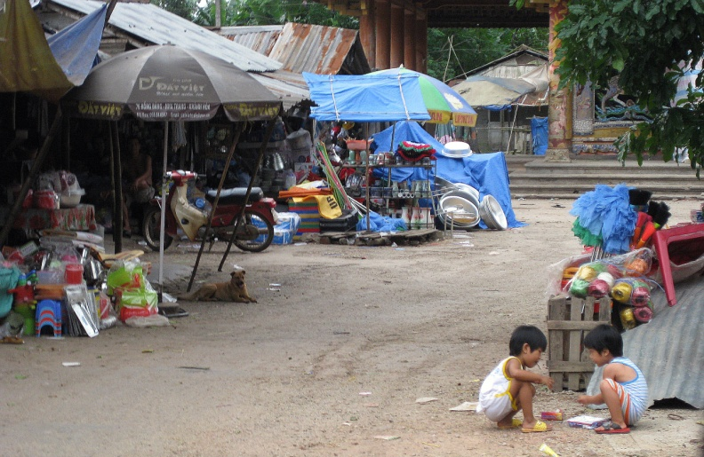
Non-farm businesses in rural Vietnam
  31.5% of households own a non-farm business in rural Vietnam (VHLSS 2008)
  20.2% of the 1st and 46.9% of the 5th income quintile own a non-farm business (VHLSS 2008)
Notes:
20.2% of the 1st and 46.9% of the 5th income quintile own a non-farm business (VHLSS 2008)
Small market, brick making, basket making, silk factory, rice wine,…
Motivation to start such a business differs.
Survival, poverty, diversification from agricultural activities
Income earning opportunity, market potentials

Slide 8
Non-farm businesses in rural Vietnam
Employment shares of working age population in rural Vietnam (main employment)
Source: General Statistics Office of Vietnam (2012)

Slide 9
Opportunity and necessity entrepreneurship
Opportunity Entrepreneurs
    …pulled into entrepreneurship by opportunity recognition.
Necessity Entrepreneurs
    …pushed into entrepreneurship because they have no other choice to earn a living
    But necessities and opportunities differ in rural areas in developing countries (see Livelihoods literature)
(REYNOLDS et al. 2002)

Slide 10
Opportunity and necessity entrepreneurship
Results for developed countries
  Two types of entrepreneurs differ in their socio-economic characteristics
  Opportunity entrepreneurs are more innovative.
  Opportunity entrepreneurs are more successful
  (Amit and Muller, 1995; Arias and Pena, 2010; Block and Wagner, 2010)
Implications for developing countries
  Opportunity entrepreneurs as drivers of structural change in developing countries?
  (Gries and Naudé, 2010; Naudé, 2010)
Notes:
Developed countries
Opportunity entrepreneurs are more successful (Amit and Muller, 1995; Arias and Pena, 2010; Block and Wagner, 2010).
Individuals beginning with a positive motivation are more likely to set up a business that grows (Storey 1994).
Practice
Policies could be designed to support specific types of entrepreneurship.
Help venture capitalists identify high from low ability entrepreneurs
(Verheul et al. 2010, Bergmann/Sternberg 2007, Amit/Muller 1995).
Greater potential to innovate, push greater specialization in manufacturing, and increase employment and productivity

Slide 11
Main questions for the analysis
How common are opportunity entrepreneurs in a rural developing environment?
How do opportunity entrepreneurs differ from necessity entrepreneurs in terms of general characteristics and in terms of human capital and skills?
Are opportunity entrepreneurs more successfull in terms of profits and employment generation than necessity entrepreneurs?

Slide 12
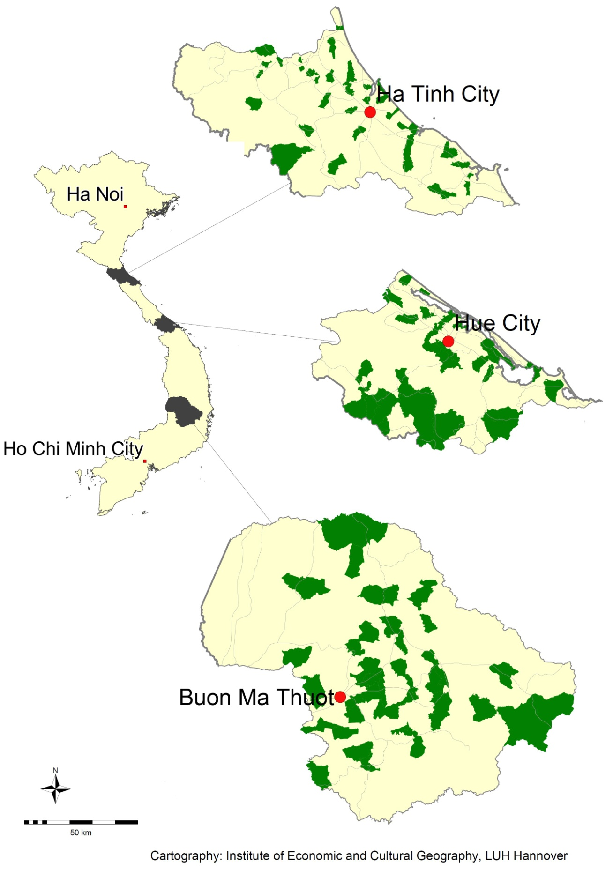
Survey design and data
DFG Research Unit 756:
  Household survey in 2010
  (2099 households / 8,939 individuals)
  Attached small business survey (N=346)

Slide 13
Data and Methodology
Asked for most important and second most important reason for starting the business
We then use two ways to distinguish opportunity from necessity entrepreneurs:
Use only primary reasons
Use primary and secondary reason
Notes:
8 categories that could mostly be assigned to either opportunity or necessity
1 others categories that allowed respondent to specify own reason – these were individually assigned to either opportunity or necessity afterwards
Previous experience in this kind of business
Saw other successful business of that kind
Figure that this kind of business can be successful
Unemployment
Insufficient income from farming
Insufficient income from agricultural job
Insufficient income from non-agricultural job
Inherited the business
Other reasons
No answer / not applicable

Slide 14
Occurence
How common are opportunity entrepreneurs in a rural developing environment?
N= 346; Missings: 9
Chi² Test on uniform distribution: p>0.1
N= 346; Missings: 9;
Chi² Test on uniform distribution: p<0.05

Slide 15
General characteristics and human capital
How do opportunity entrepreneurs differ from necessity entrepreneurs in terms of general characteristics and in terms of human capital and skills?

Slide 16
General characteristics and human capital
Commonalities:
Same sectoral structure
  Retail (27.8% vs. 25.0%)
  Wholesale (10.1% vs. 20.2%)
  Handicrafts (11.8% vs. 10.7%)
  Food processing (10.7% vs. 16.1%)
  Also: petty trading, construction, taxi and transport, restaurant/cafe/hotel, rice mills and repair shops.
Age of the owner (43.3 vs. 44.3)
Female gender (59.8% vs. 67.9%)
Ethnic minority (3.0% vs. 6.6%).

Slide 17
General characteristics and human capital
Differences
Primary employment status before starting the business
N = 346
Chi² Test: p>0.01

Slide 18
General characteristics and human capital
Differences:
Opportunity entrepreneurs…
…less often have an agricultural background (53.0% vs. 73.7%, with p<0.01)
…are better educated (8.1 vs. 6.6 years of schooling, with p<0.01)
…have more often acquired skills for the enterprise through vocational training (13.6% vs.6.6%, with p<0.05).
…are more often primary occupation (67.5% vs. 56.5%, with p<0.05)

Slide 19
Profits and employment
Are opportunity entrepreneurs more successfull in terms of profits and employment generation than necessity entrepreneurs?
Mean profits per month
Opportunity entrepreneurs: 345.8 USD
Necessity entrepreneurs: 235.5 USD
(p<0.01)
Mean number of non-family employees
Opportunity entrepreneurs: 0.6 employees
Necessity entrepreneurs: 0.2 employees
(p<0.01)

Slide 20
Performance
Multivariate regression models (OLS) and Instrumental Variable regression with control variables:
Results confirmed for profits per month
Results not confirmed for employment
  General characteristics:
  10 sectoral dummies
  Business age
  Initial investment (ln)
  Education
  Vocational skills
  Female
  Minority
  Natural shocks
  Locational characteristics
  Non-farm wage rate
  Distance to Market
  Distance to intermediate city (ln)
  Two lane road
  Thua Thien Hue
  Dak Lak

Slide 21
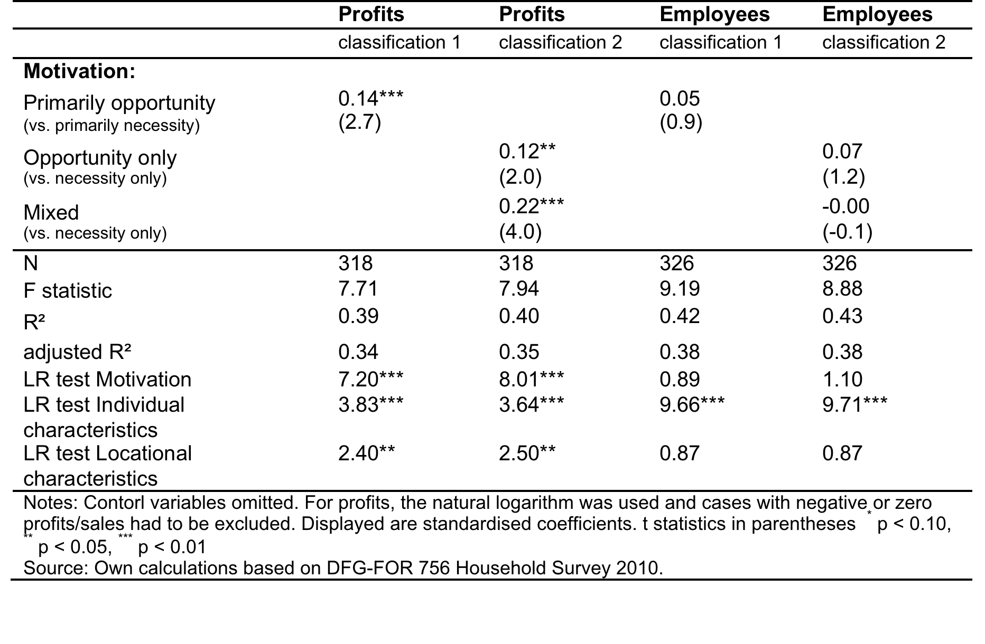
Performance
Motivation as determinant of business sucess

Slide 22
Conclusions
Necessity / opportunity entrepreneurship concept suitable in a rural developing context if contextual specifics are taken into account
Opportunity and necessity entrepreneurs have a limited capacity to generate non-farm employment for other households.
Opportunity entrepreneurs have greater entrepreneurial skills.
Opportunity entrepreneurs generate higher profits
→ Opportunity entrepreneurs scarce resource at the ‘bottom of the pyramid‘ (Prahalad, 2005)
Notes:
Necessities:
Not unemployment
Often related to agricultural production
Opportunities
Often relate to local market potentials or to business models that are new to an area.
Less often involve technological upgrading and innovation
Many entrepreneurs motivated by a combination of both necessity and opportunity (Giacomin et al., 2011; Hughes, 2003; Solymossy, 1997).
Opportunity entrepreneurs in rural areas of developing countries are also not comparable to those of developed countries.
They have a farming background less often but instead have been involved in non-farm businesses before or started their business directly after school or university more often. As a consequence they are better educated and more experienced in doing business.
Starting a business out of necessity is thus not automatically a hopeless endeavour. Necessity entrepreneurs are only less successful if they do not perceive an opportunity at the same time. However, like necessity entrepreneurs, opportunity entrepreneurs
This may be because perceived opportunities in the rural environment rarely relate to innovative business ideas and businesses are often not oriented towards employment growth.

Slide 23
Thank you for listening!

Slide 24
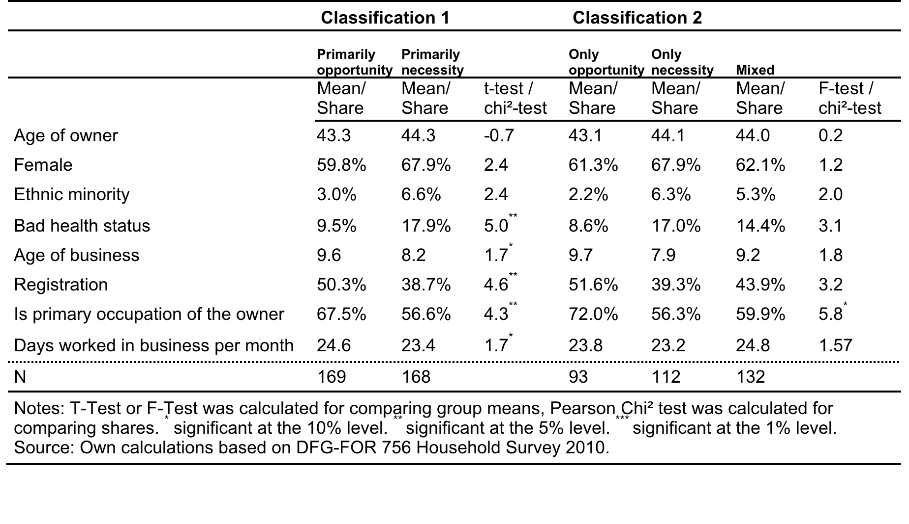
General characteristics

Slide 25
General characteristics and human capital
Table: Sectoral Distribution
 | Opportunity | Necessity | chi²-test
Rice Mills | 4.7% | 2.4% | 1,4
Handicrafts | 11.8% | 10.7% | 0,1
Repair shops | 5.3% | 3.0% | 1,2
Construction | 5.3% | 1.8% | 3.1*
Food processing and selling | 10.7% | 16.1% | 2,1
Restaurant/cafe/hotel | 6.5% | 3.0% | 2,3
Retail-Shop (sales store) | 27.8% | 25.0% | 0,3
Petty trader (sales on street) | 7.1% | 8.3% | 0,2
Wholesale | 10.1% | 20.2% | 6.8***
Taxi and transport | 2.4% | 6.6% | 3.5*
Others | 8.3% | 3.0% | 4.5**
Total | 100% | 100%
N | 169 | 168
Notes: T-Test or F-Test was calculated for comparing group means, Pearson Chi² test was calculated for comparing shares. * significant at the 10% level. ** significant at the 5% level. *** significant at the 1% level. Source: Own calculations based on DFG-FOR 756 Household Survey 2010.

Slide 26
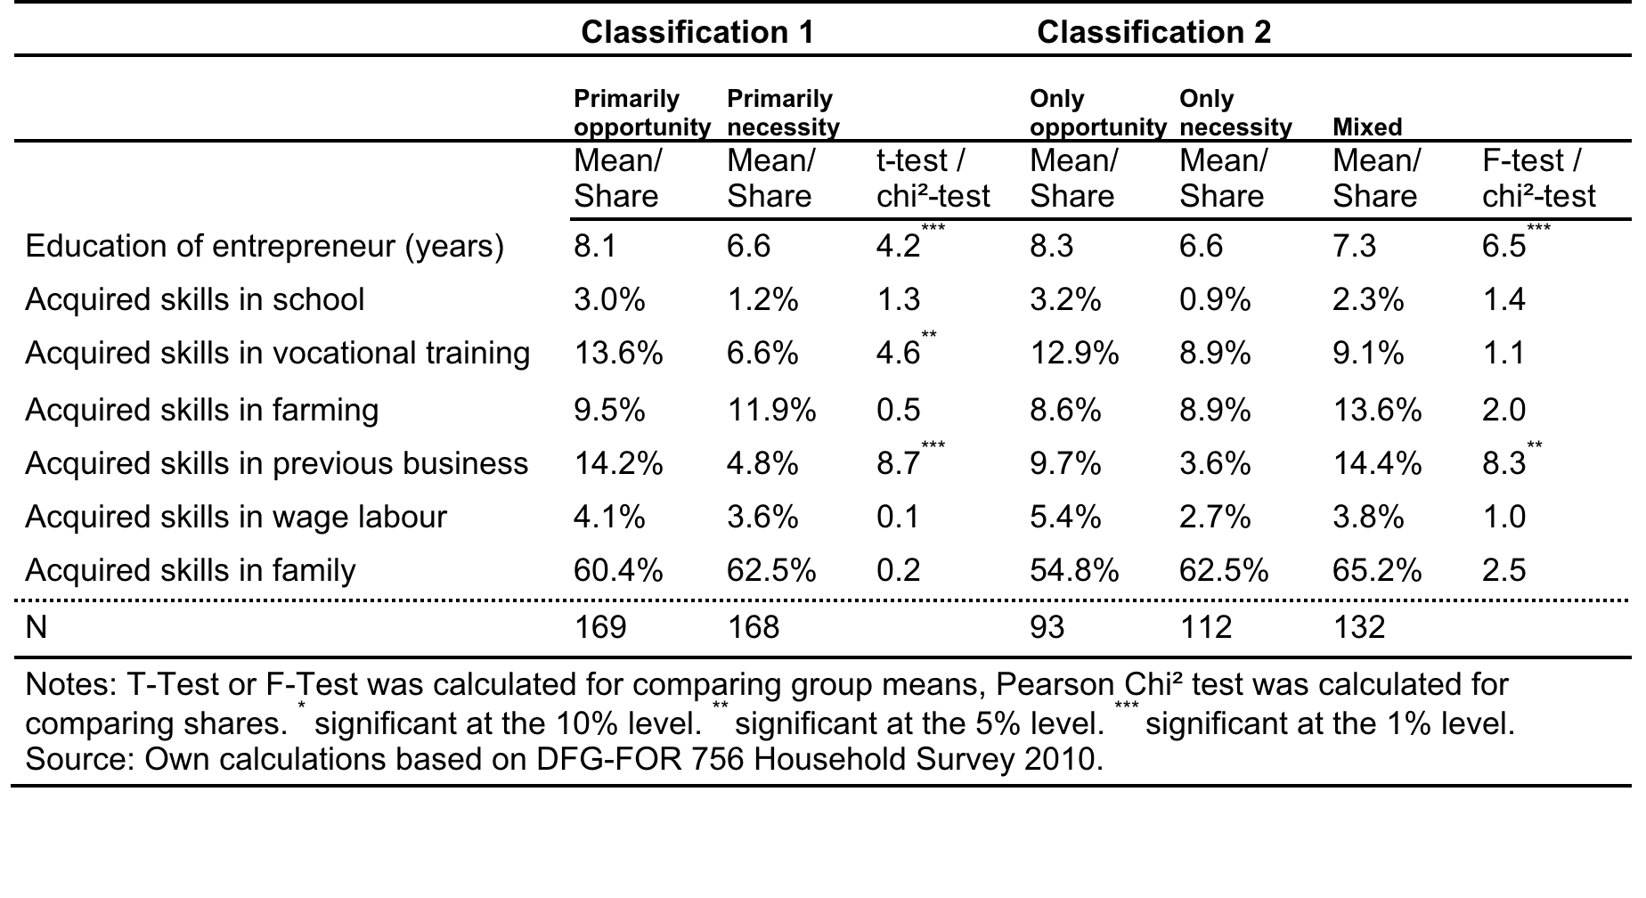
Education and skills

